Slide 1
The State Assistance for Housing Relief (SAFHR)
The Vincentian Version
Presented By:
Vincentian Lynn Chapman Wolf, LCSW
“I will always welcome joyfully any opportunity that comes my way to be of service to you.”
-St. Vincent de Paul

Slide 2
Opening Prayer
Lord, Open my eyes to know and attend the needs of our Neighbors in Need,
Help me to express ideas with kindness and patience,
Touch my heart that I may listen to, learn from and appreciate the ideas of colleagues,
Help me communicate with politeness,
Come, Holy Spirit, Live Within Our Lives and guide our decisions,
We partake of your divine presence,
Amen.

Slide 3
Introductions
Lynn Chapman-Wolf is a Vincentian and a member of the St. Gabriel the Archangel Conference in south St Louis. Lynn is trained clinical social worker, currently employed at Women In Charge, a small non-profit helping women prepare to take their high school equivalency exam and secure employment. Lynn has a 100% success rate in helping Neighbors compete the SAFHR application and receive the rental assistance they need.

Slide 4
Overview
SAFHR is the Rental Assistance Program for anyone living in Missouri.
SAFHR will be accepting applications until September 2022.
The SAFHR program is preferable to the St. Louis County or City Cares Programs, because:
The County Cares program has allocated 99.9% of their funding and takes an average of 57 days to be reviewed.
The St. Louis City Cares program takes 4-6 weeks to be assigned to an agency for review. United Way 211 handles all calls for the program which can be frustrating.
The Landlords I’ve spoken with have never received any payments from the CARES programs.

Slide 5
Resources -Places to find info and help for SAFHR
Program Info: mohousingresources.com Application: safhr.smapply.org Help: 1-833-541-1599

Slide 6
Preparing to Help a Neighbor
As a Vincentian and SAFHR advocate, be prepared to help the Neighbor in Need (NIN) complete the actual application.
You may have to reach out to the landlord or apartment manager to explain the application process and how and what they will be required to do in order complete the application.

Slide 7
Preparing to Help a Neighbor (cont’d)
To apply for SAFHR: A computer, internet access and email account is required. A mouse is normally used for the signature part of the application.
I’ve helped several people apply for SAFHR using my personal laptop. We’ve met at the public library or Panera where we could use the free WI-FI.
Neighbors can apply on a mobile device but must apply with the Google Chrome or Foxfire app. This should be a last option as it’s hard to navigate the application on a mobile device screen.

Slide 8
Applying for SAFHR
When helping with the application, please get permission from the NIN to write down the login email & password.
Suggestion for the password: Use is the address of the applicant plus the $ for the special character. For example: 6303Nottingham$
With the login email and password, you can check on the status of the application and help troubleshoot or make any needed corrections.

Slide 9
Uploading Documents
This is where applicants need the most help and make the most mistakes. Take a picture of the document and save it to a file or email to yourself in order to include it in the application.

Slide 10
Tenant Documents Needed
Photo ID
Valid Lease for the time period of requested Rental Assistance. Must be signed by both Tenant and Landlord
A “Rental Attestation” may be submitted in place of Valid Lease. Rental attestation form is found on the SAFHR website. Need proof of rent payments with attestation form.
Letter or Ledger showing back rent.
Copies of Utility bills (I don’t recommend asking for utility assistance with this application.)
Any bills that show hardship. Ex: Medical bills
Copies of documents for automatic qualifying programs

Slide 11
Automatic qualifying programs
Supplemental Nutrition Assistance Program (SNAP)
Temporary Assistance for Needy Families (TANF)
Supplemental Security Income (SSI)
Women, Infants, and Children (WIC)
Head Start
Earned Income Tax Credit (EITC)
Medicaid

Slide 12
Past Due and Forward Rent
SAFHR will pay up to 12 Months rent.
If an applicant has less then 9 months of back rent owed, recommend the Neighbor request 3 months of forward rent.
If less than 12 months of rent are requested, the applicant can make a second application in the future as long as they do not exceed 12 months total rent request.

Slide 13
Landlord Portion of the SAFHR Application
As a SAFHR Advocate, you are helping the landlord as much as the tenant to ensure the success of the application.
Be sure to listen to the frustration of the landlords. Usually, the tenant or NIN has a history of non or late rent payments.
Landlords will need to provide: Copy of ID, W-9 form, Voided Check or Bank statement, Account number, Routing number, and Tax Records for the property. (Property tax records can be found on the city or county websites)
Landlords need to provide a letter with how much rent is owed. Letter must include landlord’s name and address
Payment to Landlords is not immediate, normally 3-4 weeks after the application is approved.

Slide 14
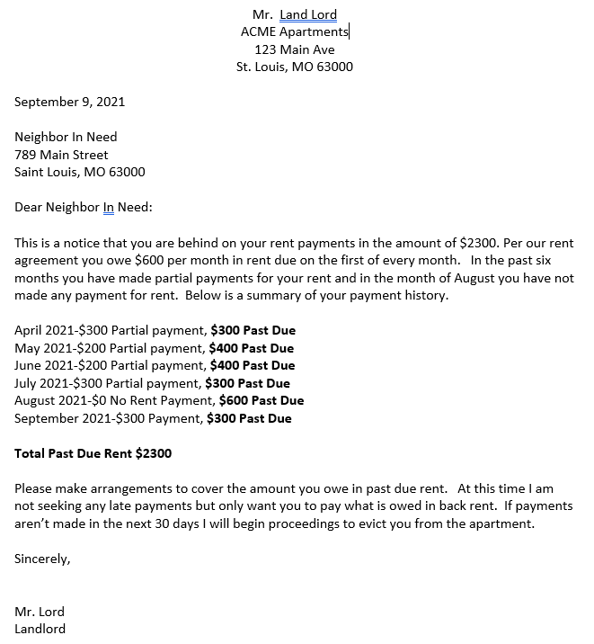
Example a Landlord’s Letter to Tenant

Slide 15
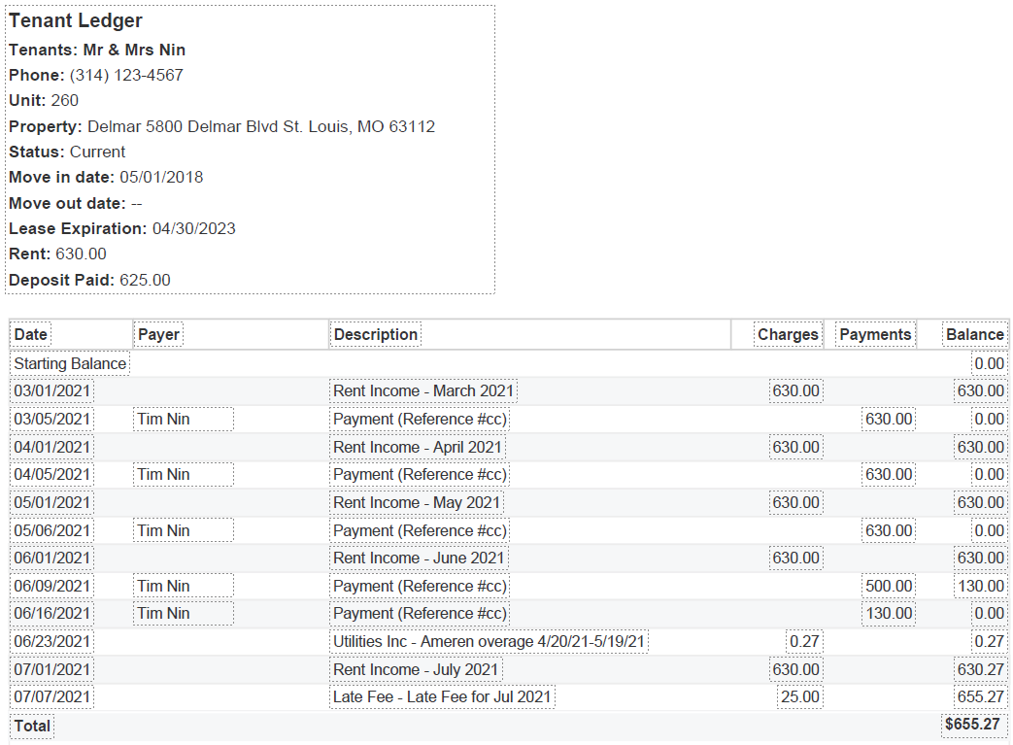
Example of a Rent Ledger

Slide 16
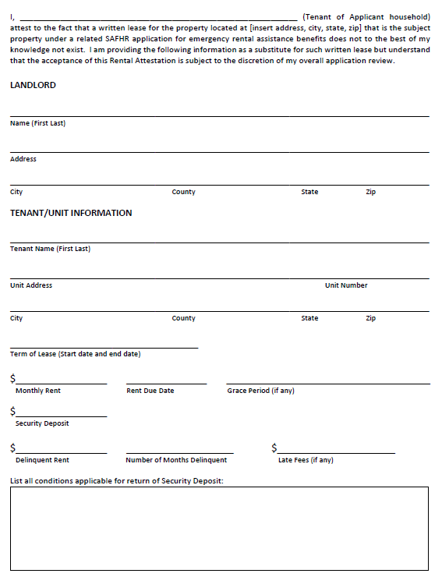
Example of a Rental Attestation Form (pg1)

Slide 17
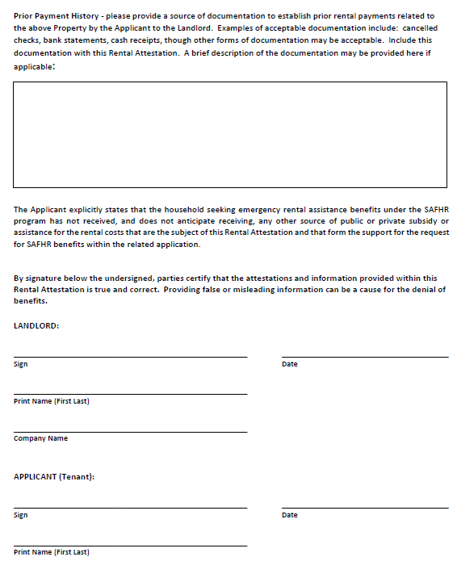
Example of a Rental Attestation Form (pg 2)

Slide 18
If you need help, please reach out!
Email: lcwolf@sbcglobal.net
Call or text: 314-324-8714
I’m happy to review submitted applications. Please Provide Application #, Login email & Password
I am only available to help by email or in person from 1pm-4pm.

