Slide 1
The Current State of Immigration

Slide 2
Who are the foreign born?
45.3 Million Immigrants as of 2021
13.6% of the U.S. population
4.1% of Missouri population
Categories of Immigrants:
“Lawful” or “Legal” Permanent Resident (LPR)—greencard holders
Naturalized Citizens
Non-Immigrant Visa Holders
Refugee/Asylees
Undocumented Persons
*Statistics are from the Migration Policy Institute (MPI)

Slide 3
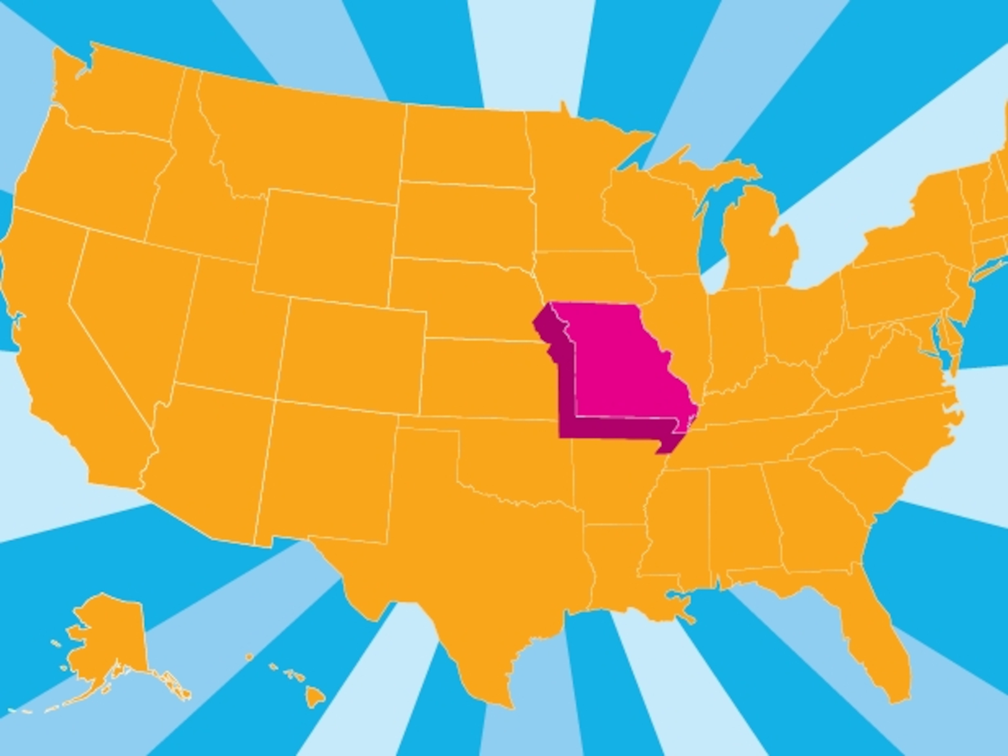
Missouri and Immigration
Missouri is ranked 41 out of 50 states for percentage of foreign-born residents
St. Louis County 76,300 immigrants
St. Louis City 20,600 immigrants
St. Charles County 16,300 immigrants
In 2023, St. Louis experienced the largest one-year increase in it immigrant population (15 counties-have largest population on record)**
In addition to the 4% immigrant population, another 4% are citizens with at least one immigrant parent
An estimated 60,000 immigrants in Missouri are undocumented, 1% of the population
Immigrants make up 5% of the Labor Force (compared to 17% of US Labor Force)
*Statistics from MPI
**ACS Data

Slide 4
Citizenship and Legal Status of the US Foreign-Born Population, 2019
Source: MPI

Slide 5
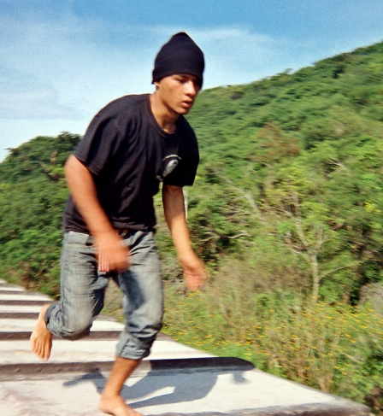
Why Do People Migrate?
Better life for their children
Better Education/More employment opportunities
Economic Hardship in country of origin
Family connections in the U.S.
Inhospitable environments in country of origin
Notes:
Reasons for migration:
-Rejoining family already in the United States -Fleeing violent communities or abusive family relationships -Find work to support their families
-Access to education and health care
OJO - Migration is not always a CHOICE - how do we think about CHOICE - when did we DENY THEIR CHOICE? (ie denial of right to stay home)

Slide 6
Our National Immigration Crisis
Immigration System is badly outdated:
Almost no employment visas for persons without a college degree, despite our need for “low-skilled” labor
One must have a close U.S. citizen relative (e.g. spouse, parent, or adult child) to receive an immigrant family visa.
Immigration Reform has been stalled in Congress
Immigration Courts have a 1.3 million case backlog-over 49,000 in our Court

Slide 7
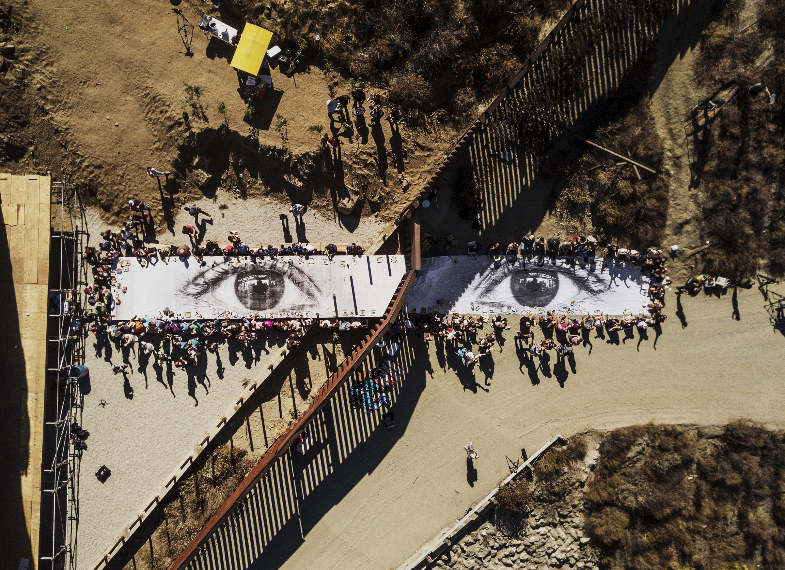
“Coming Legally” to the United States
JR/Twitter
Notes:
no visa category for “I want to live in US”
no form or fee or penalty for “I want to fix my legal status”

Slide 8
Immigration Pathways
Humanitarian
Family Unification
Employment
Unauthorized immigration
Citizens: spouse, parents, minor children (no cap)
Citizens: adult children, siblings (preference category)
Employer sponsored
Refugee
Overstay visa
Asylum (once in the U.S.)
Special person
Cross border
Temporary visas
U Visas/T Visas
VAWA
LPR: spouse, minor and adult children
Diversity lottery
Notes:
How it looks now
Not going into this

Slide 9
Visa Bulletin – February 2025
Family- Sponsored | All Chargeability Areas Except Those Listed | CHINA-mainland born | INDIA | MEXICO | PHILIPPINES
F1 | 22NOV15 | 22NOV15 | 22NOV15 | 22NOV04 | 08MAR12
F2A | 01JAN22 | 01JAN22 | 01JAN22 | 15MAY21 | 01JAN22
F2B | 22MAY16 | 22MAY16 | 22MAY16 | 01JUL05 | 22OCT11
F3 | 01JUL10 | 01JUL10 | 01JUL10 | 22NOV00 | 08NOV02
F4 | 01AUG07 | 01AUG07 | 08APR06 | 01MAR01 | 01MAY04
First: (F1) Unmarried Sons and Daughters of U.S. Citizens. Second: (F2A) Spouses and Children of Permanent Resident; (F2B) Unmarried Sons and Daughters (21 years of age or older) of Permanent Residents Third: (F3) Married Sons and Daughters of U.S. Citizens Fourth: (F4) Brothers and Sisters of Adult U.S. Citizens

Slide 10
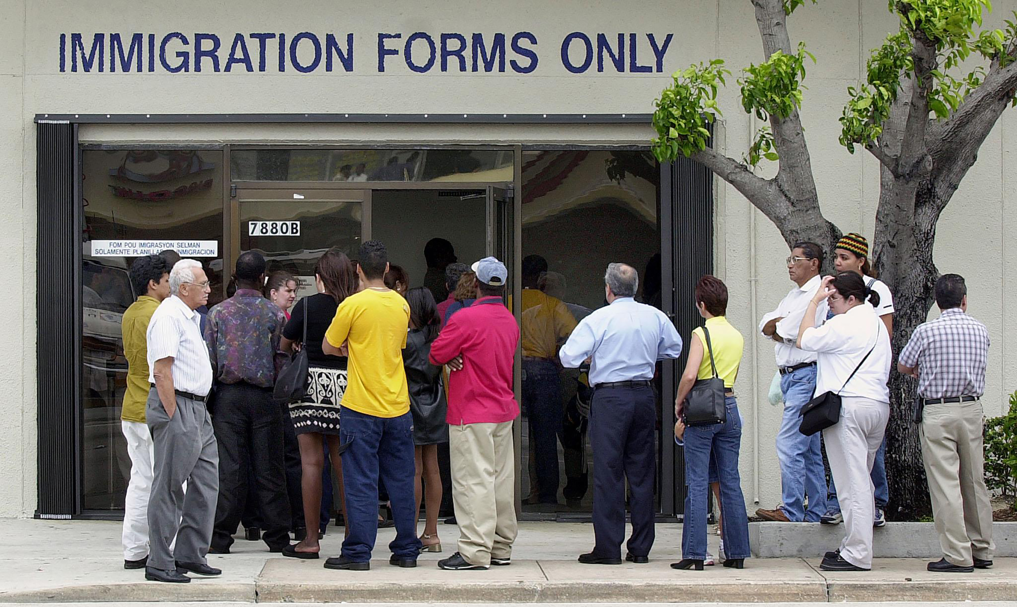
Undocumented Persons’ Options
If you do not meet requirements for other visas or U.S. citizenship, options are extremely limited
There are no lines to “get in,” applications to apply for, or fees to pay
Lack of options lead many to “lay low” or be “in the shadows” to avoid drawing unwanted attention that may lead to deportation of that person and perhaps other family members, back to their country of origin
AFP/Getty Images

Slide 11
Who is the most at risk?
A person who is not a citizen and has criminal history
A person who has a prior deportation order
People who violated their visas or without any legal status

Slide 12
What rights do I have?
You have the constitutional right of the “reasonable expectation of privacy”
The degree of protection varies by location
House
Work
Car
The street/ public areas

Slide 13
IN ANY CASE OR SITUATION
DO NOT lie or give a false name or document
DO NOT sign anything
REMAIN SILENT except to ask for a lawyer.
If the arrest takes place in the home, let the officer know of any children and anyone who has a medical condition requiring care.

Slide 14
How can I prepare my family?
Talk to your family members about a plan
If you have minor children – arrange for their care
○ Limited power of attorney forms can be helpful (state specific)
○ Have emergency contact/caretaker aware of medications or medical needs of children
○ Communication with school about alternate caretaker
○ Collect important documents for children
Have family members memorize important phone numbers

Slide 15
QUESTIONS?

